Slide 1

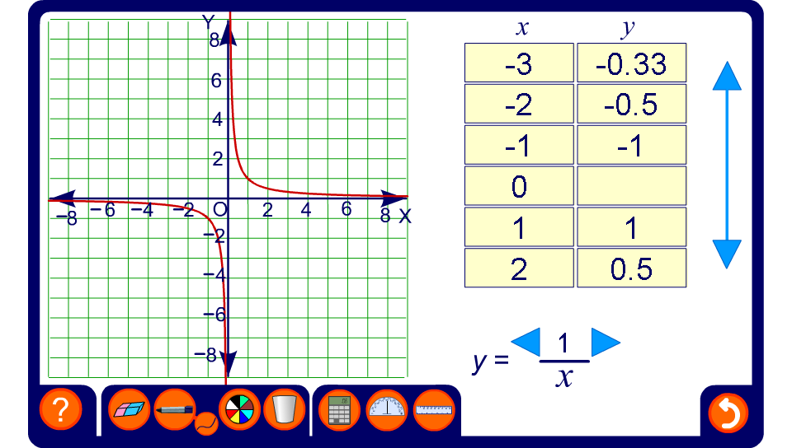


Exploring reciprocal graphs
Notes:
Point out the basic features of the reciprocal graph. Draw particular attention to its asymptotes formed by the x- and y-axes.
Explore the effect of changing the constant.
By considering very large and very small positive and negative values of x, discuss why the curve approaches, but doesn’t touch, the x- and y-axes.

